Slide 1

1

Slide 2
WSO2 - API Publisher
FEATURES

Slide 3
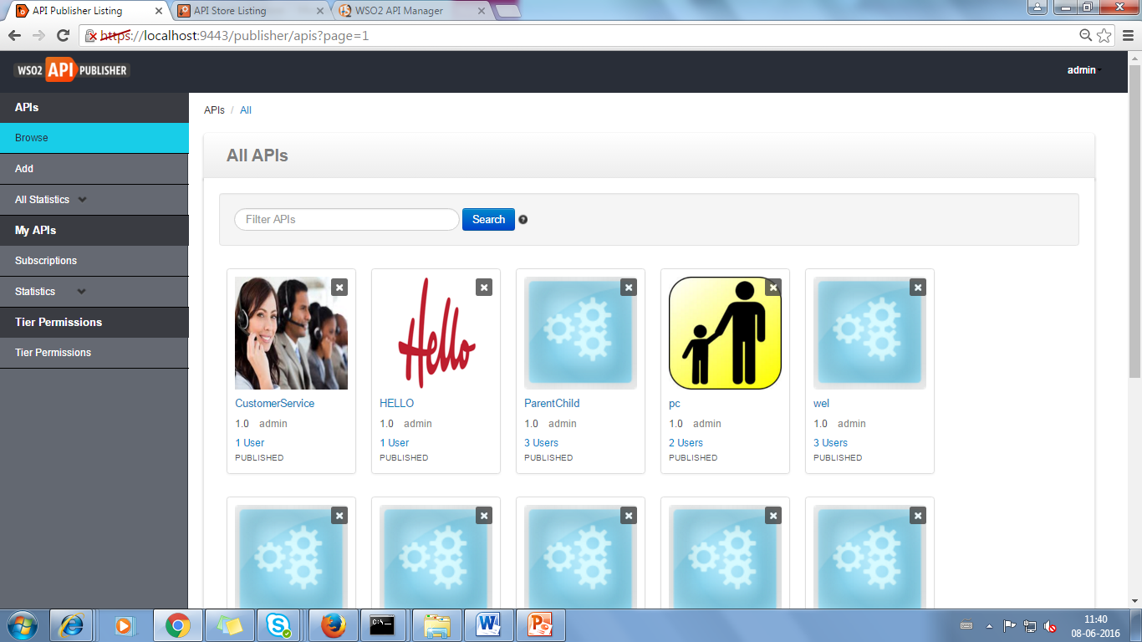
Contents
APIs
Browse
Add
All Statistics
My APIs
Subscriptions
Statistics
Tier Permissions
Tier Permissions

Slide 4
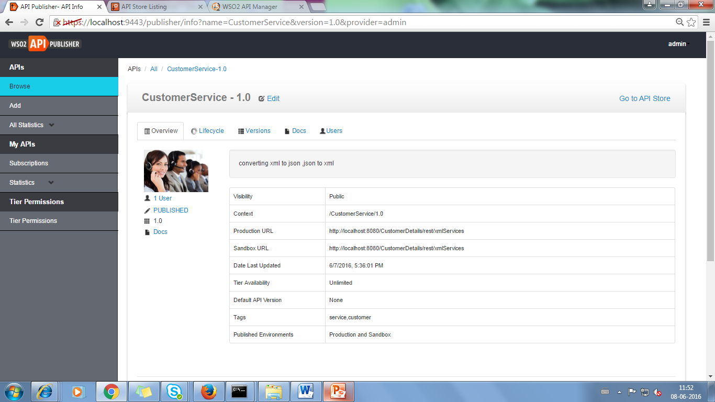
APIs
Browse
-> It contains all the API,which has been created by particular logged in user.
-> we can make changes by clicking edit in the corresponding API.

Slide 5
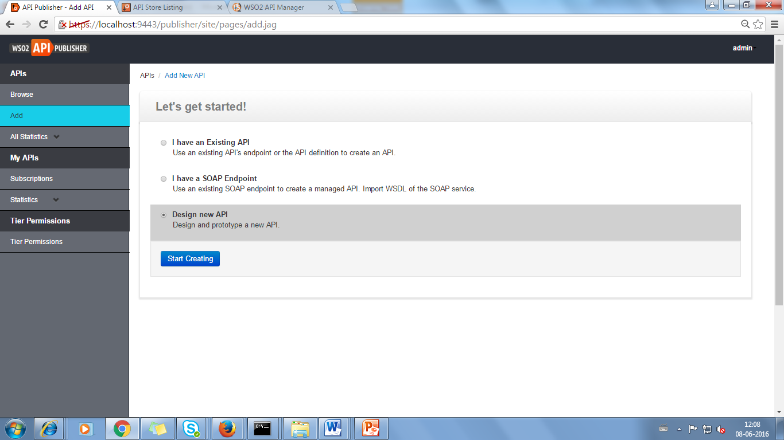
APIs
Add
select ->Design new API- to add new service in the API

Slide 6
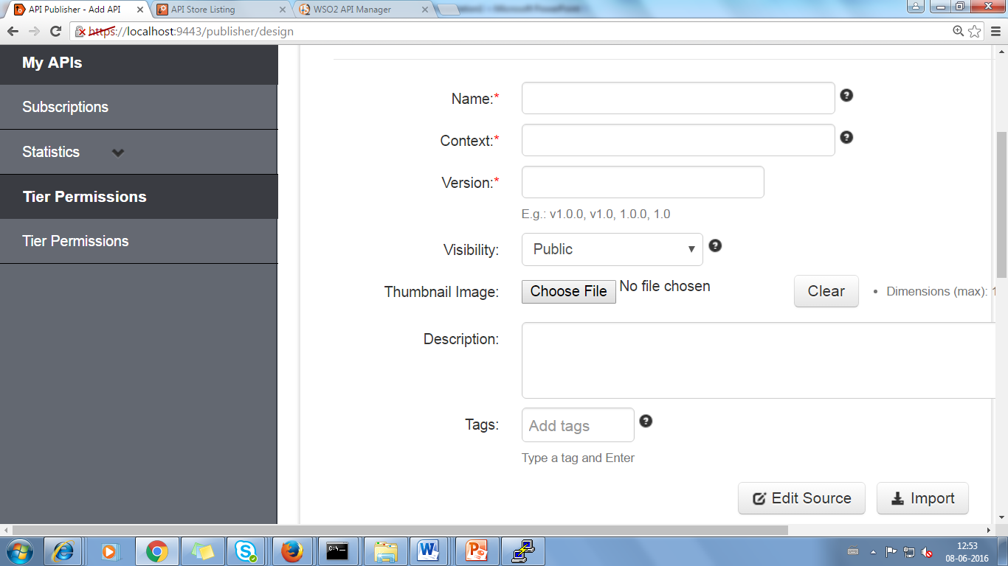
Design New API
There are three phases in this
Design-First Phase
General Detail
Name
Display name to be shown in the API Store.
Context
URI context path of the API (case sensitive). The supported formats are.. 1. /foo 2. /foo/bar 3. /foo/{version}/bar (case sensitive) - allows the version to be within the context
Version
Display version number

Slide 7
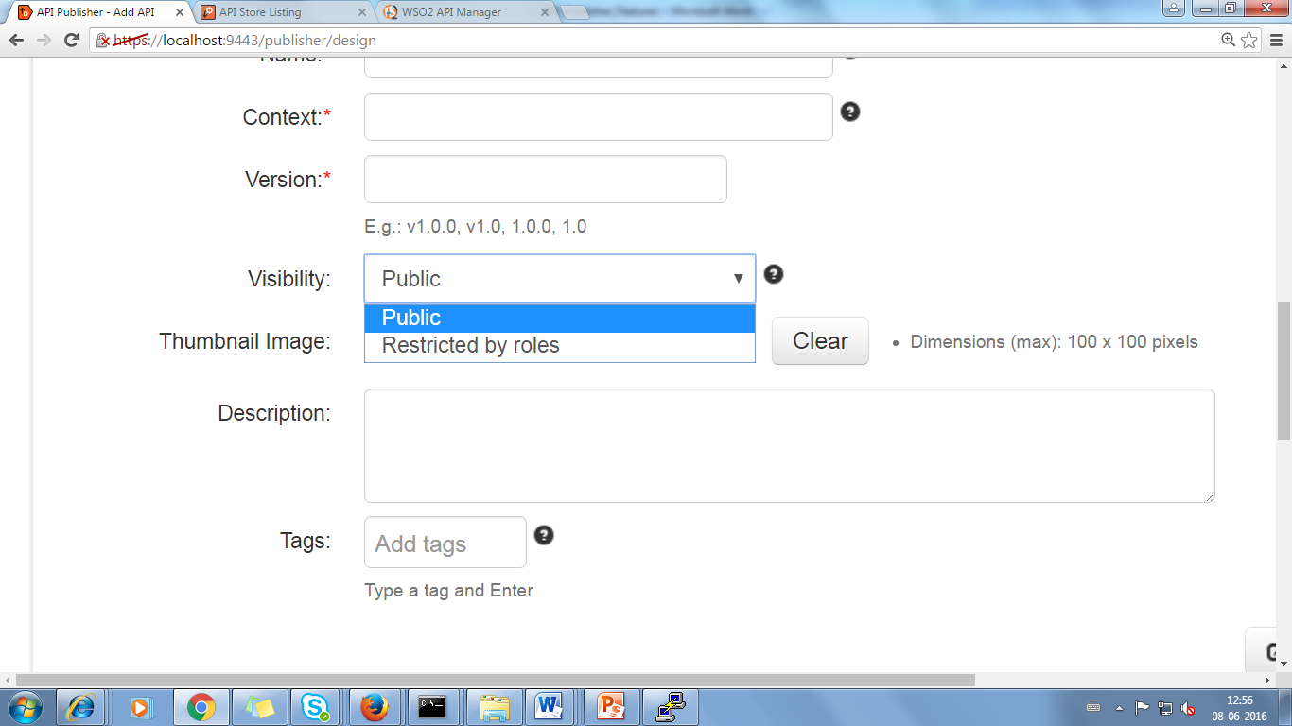
Design New API
Visibility
Public : The API is accessible to everyone and can be advertised in multiple stores - a central store and/or non-WSO2 stores.
Visible to my domain : The API is visible to all users who are registered in the API's tenant domain.
Restricted by roles : The API is visible only to specific user roles in the tenant store that you specify.
Description
Can Describe about the Service
Tags
Can used to search API

Slide 8
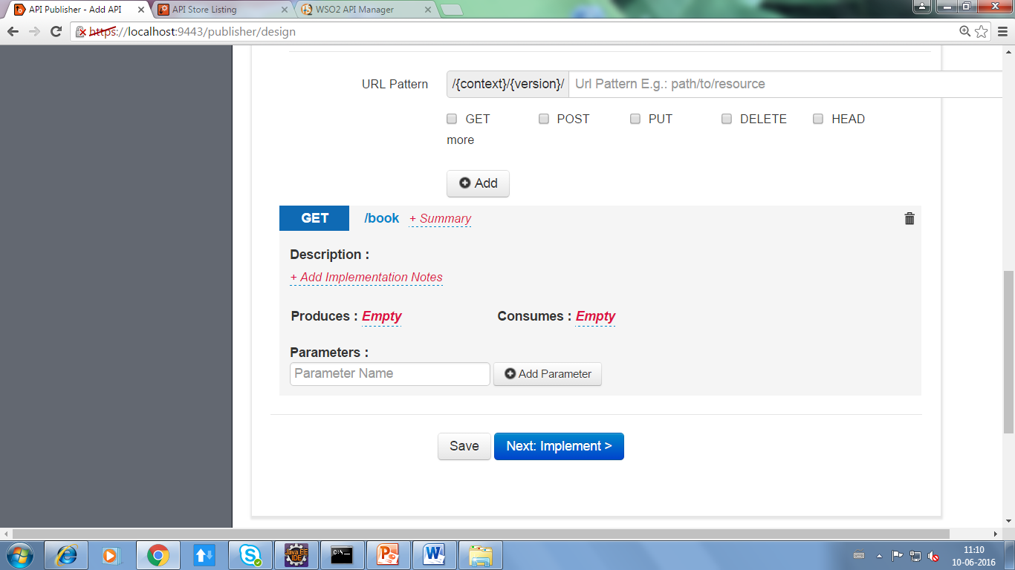
Design New API
API Definitions
In URL Pattern–version and context will appear ,along with we have to give path name which is at the end
It is necessary to add the method , in which we have to mention produces and consumes of that method

Slide 9
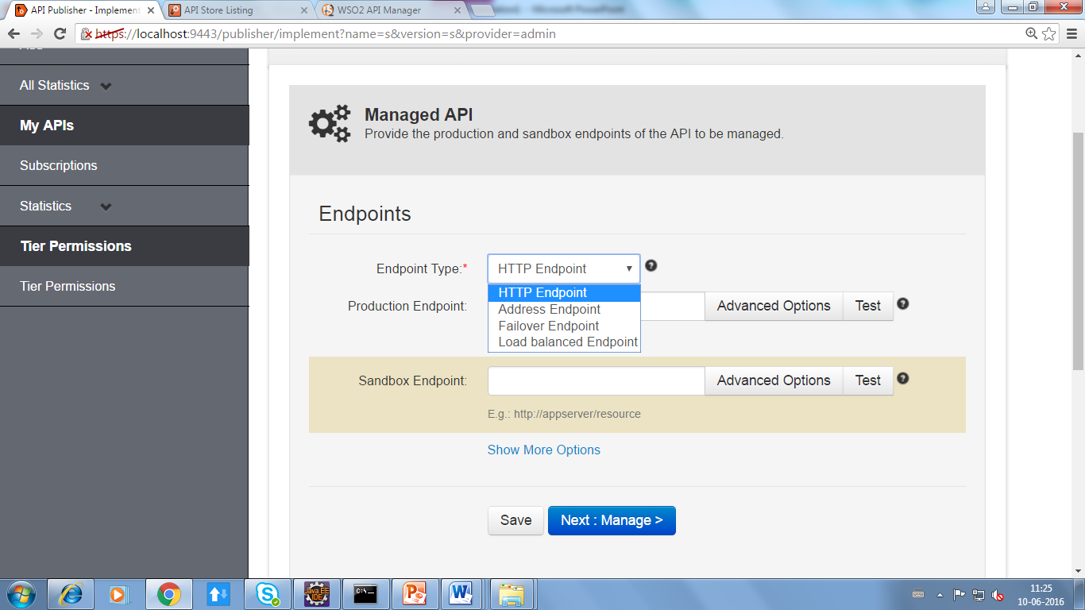
Managed API
Provide the production and sandbox endpoints of the API to be managed
Implement-Second Phase
ENDPOINTS
An endpoint defines an external destination for an outgoing message through WSO2 ESB
HTTP Endpoint
A REST service endpoint based on a
URI template

Slide 10
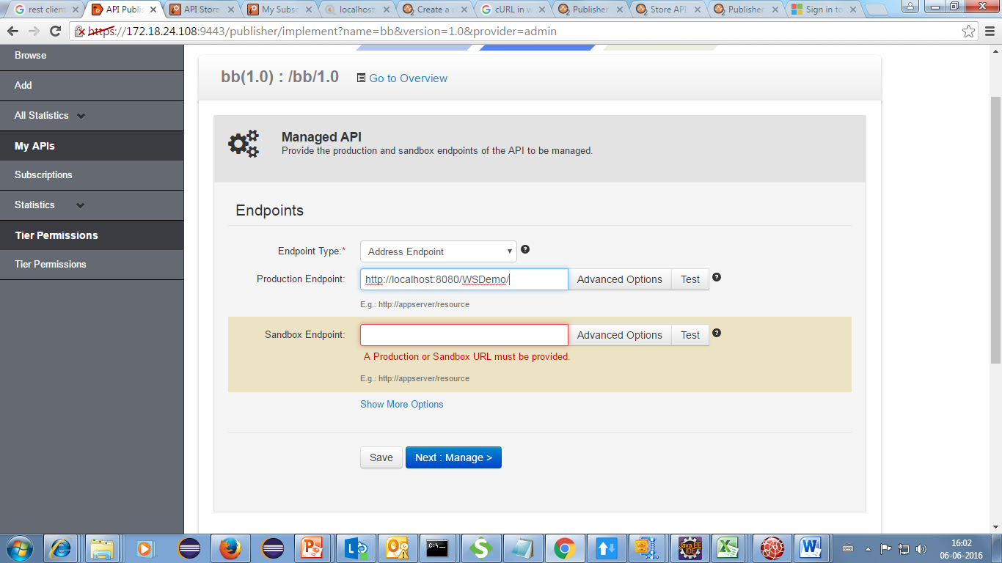
Address Endpoint
The direct URL of the service
Address endpoint instead of http endpoint
No sandbox endpoint required

Slide 11
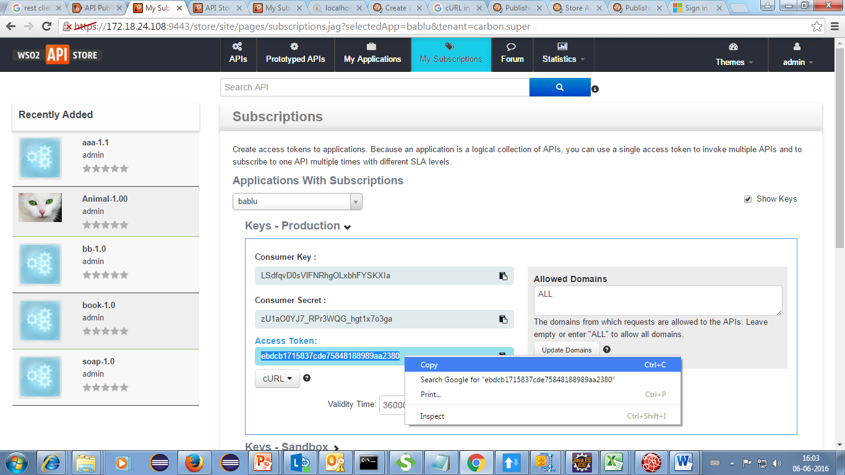
In the WSO2-API Store
Copy production token key

Slide 12
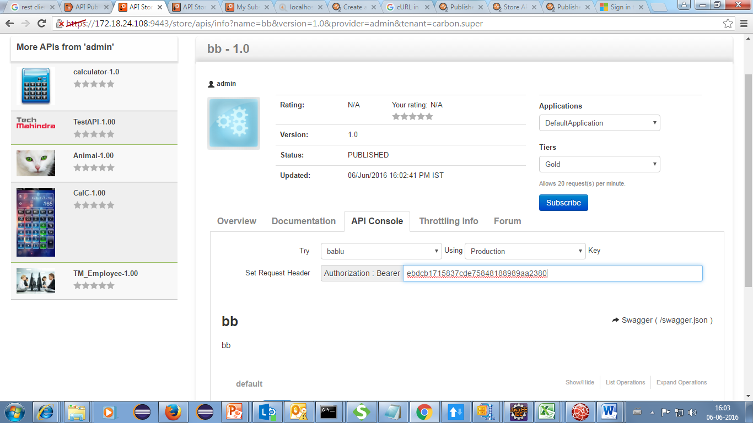
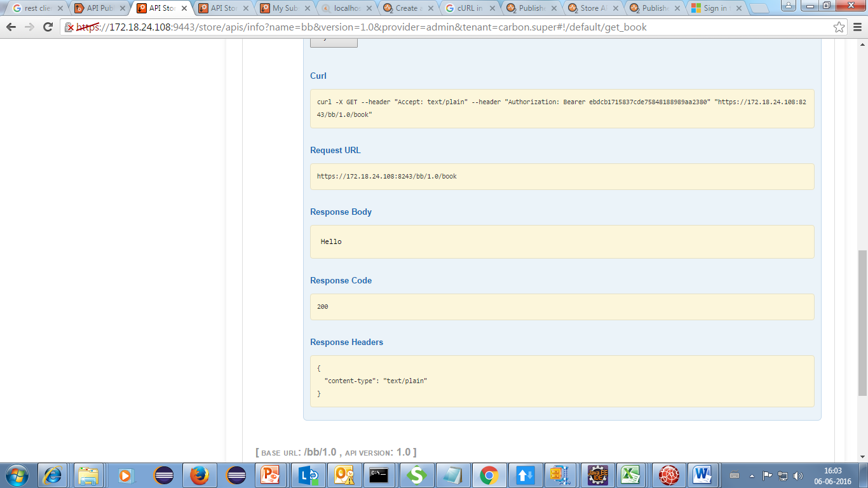
In the WSO2-API Store
Same output as http endpoint
Paste it in the api console

Slide 13
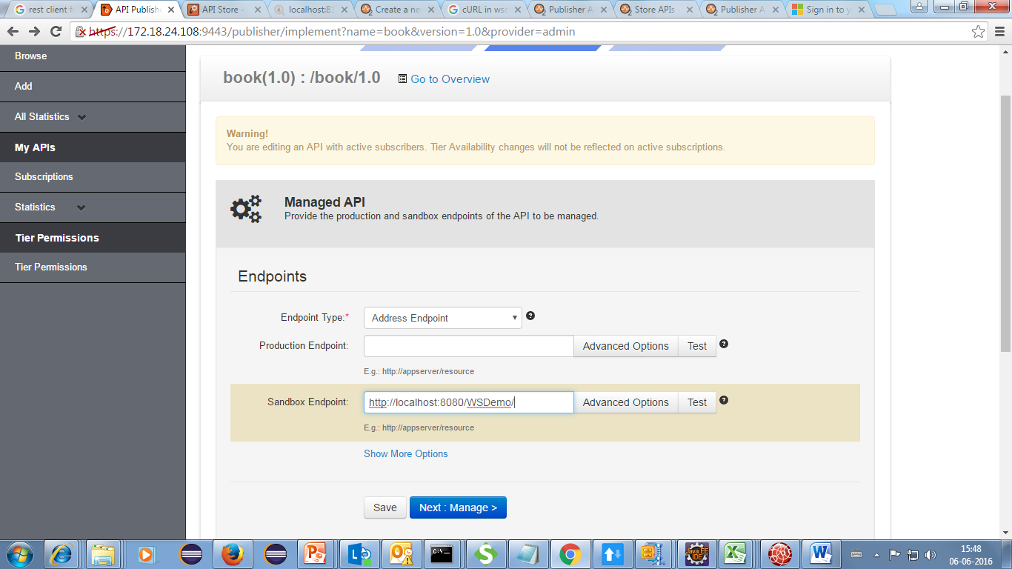
When we giving endpoint in sandbox
Only Sandbox provided

Slide 14
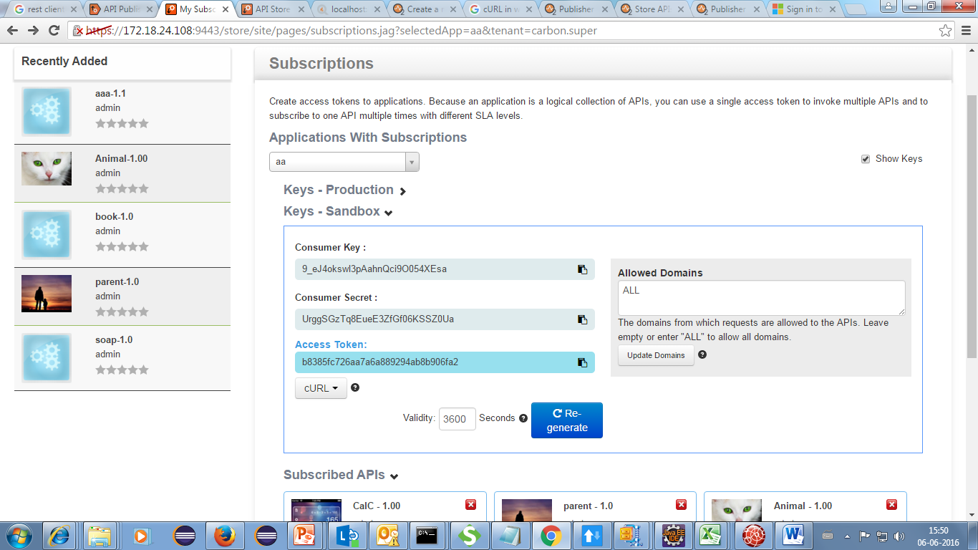
While following same procedure in API –store , instead of production key have to copy the sandbox key same output will be produced.Output will be same as production endpoint
Sandbox key generated

Slide 15
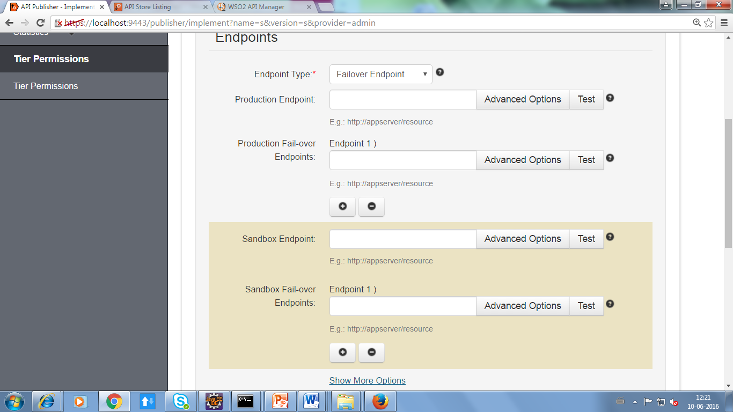
Failover Group
The endpoints that the service tries to connect to in case of a failure. This happens in a round robin manner.

Slide 16
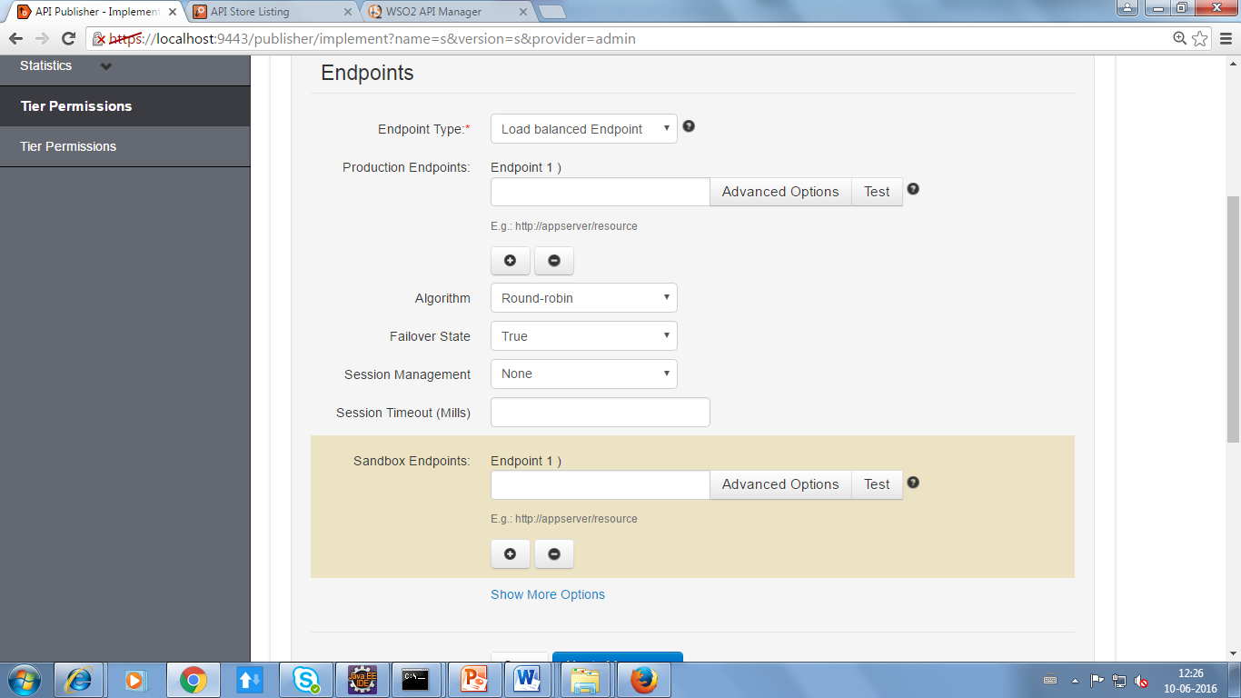
Load Balance
The endpoints where the incoming requests are directed to in a round robin manner. They automatically handle fail-over as well

Slide 17
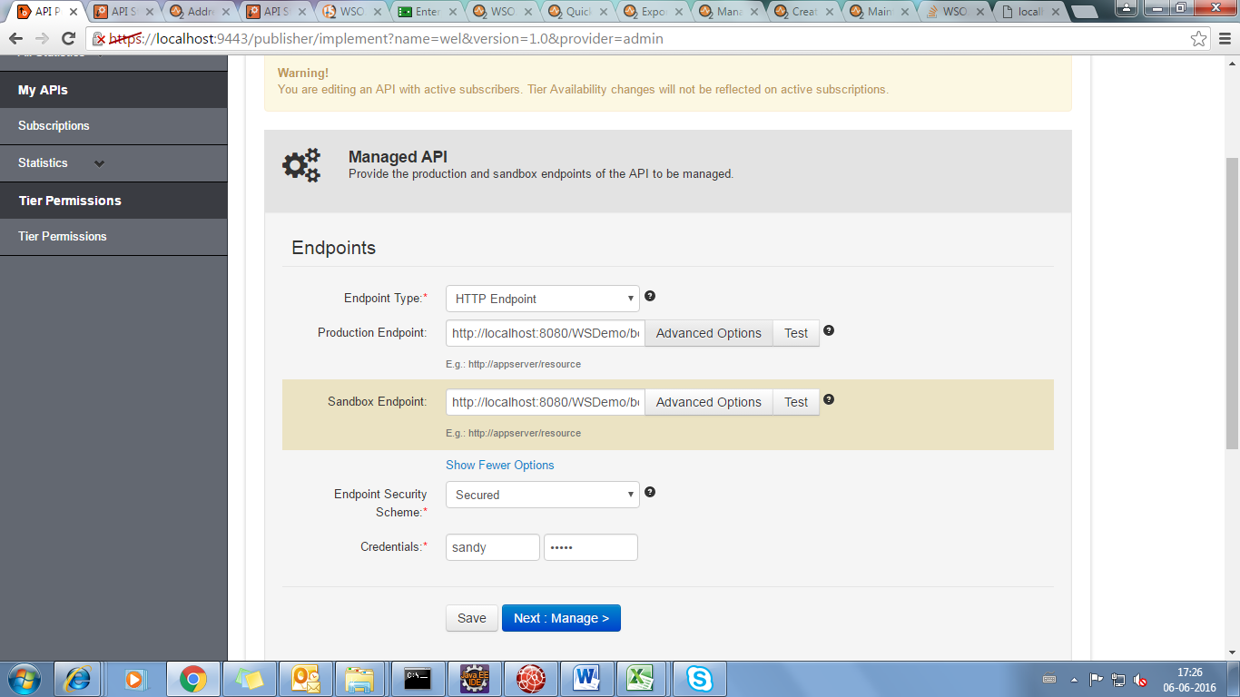
If we click on (show more options)
Endpoint Security Scheme
If secured endpoint is selected, user is asked for credentials of the backend service.

Slide 18
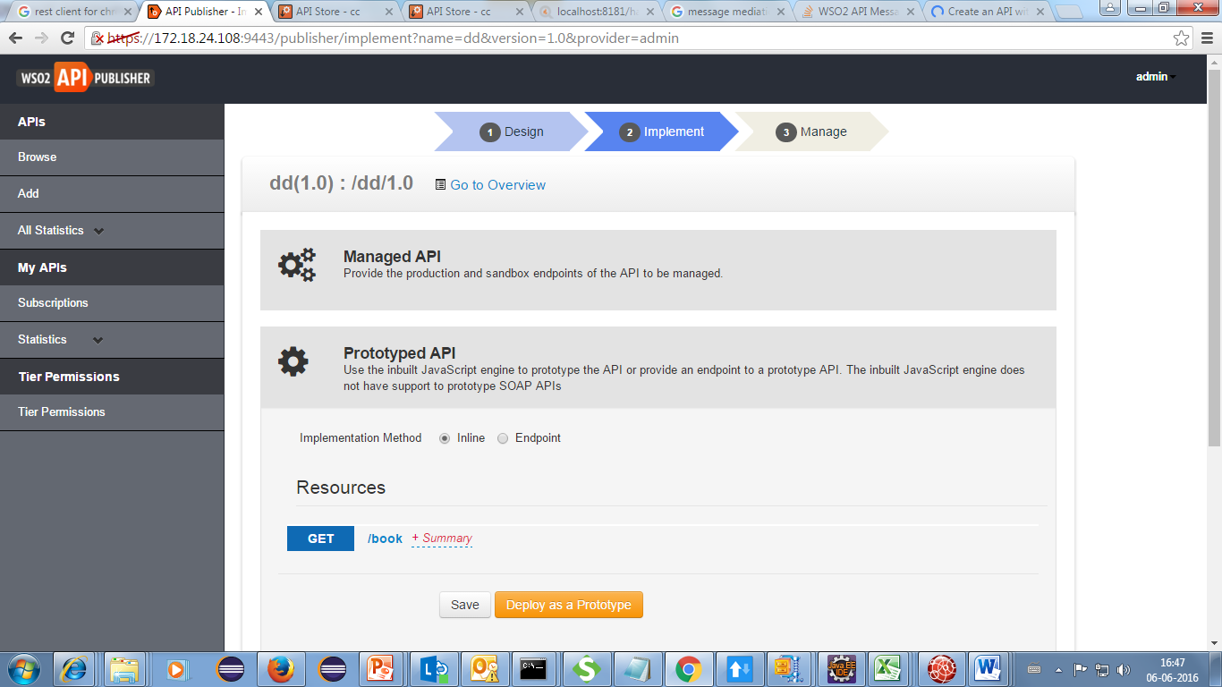
Prototyped API
Use the inbuilt JavaScript engine to prototype the API or provide an endpoint to a prototype API. The inbuilt JavaScript engine does not have support to prototype SOAP APIs
Inline
Select inline

Slide 19
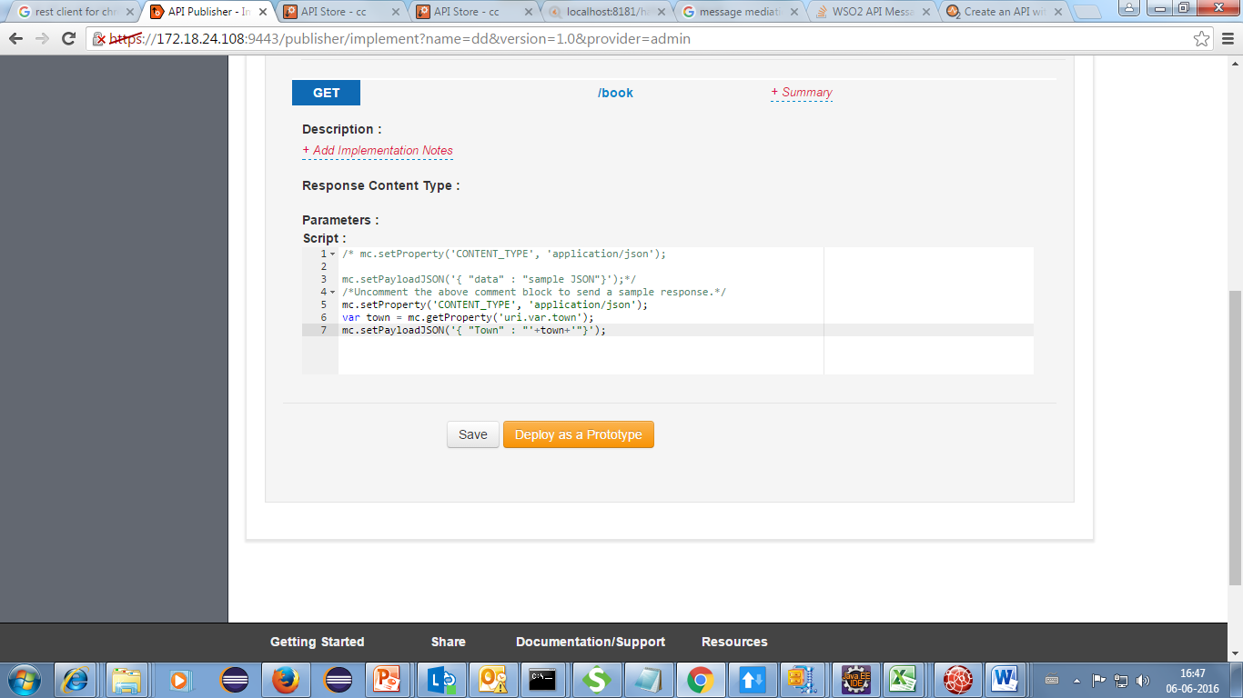
Expand get method in the inline
In the script verification code ic provided

Slide 20
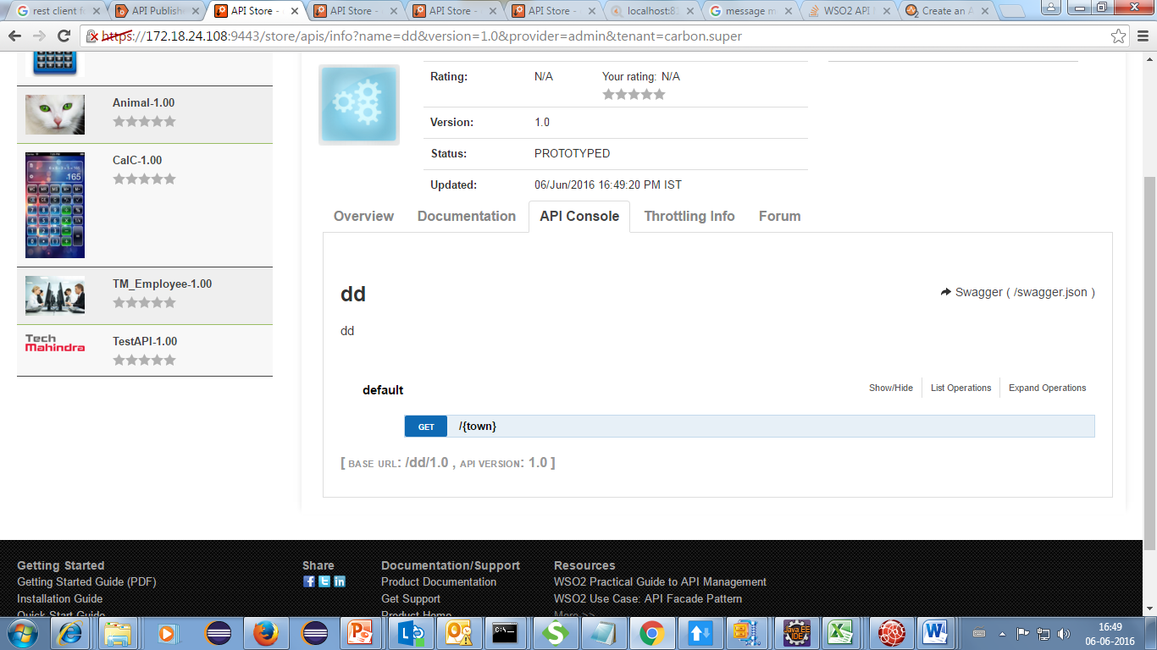
In WSO2 API Store
No token generated
Deploy as prototype and in store go to console

Slide 21
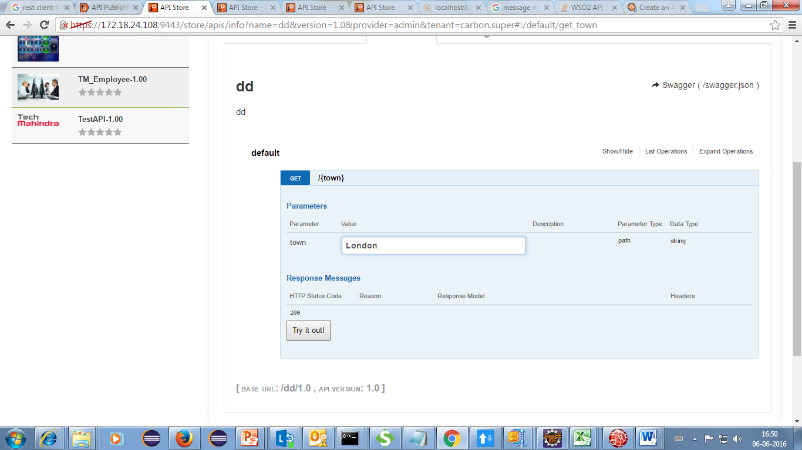
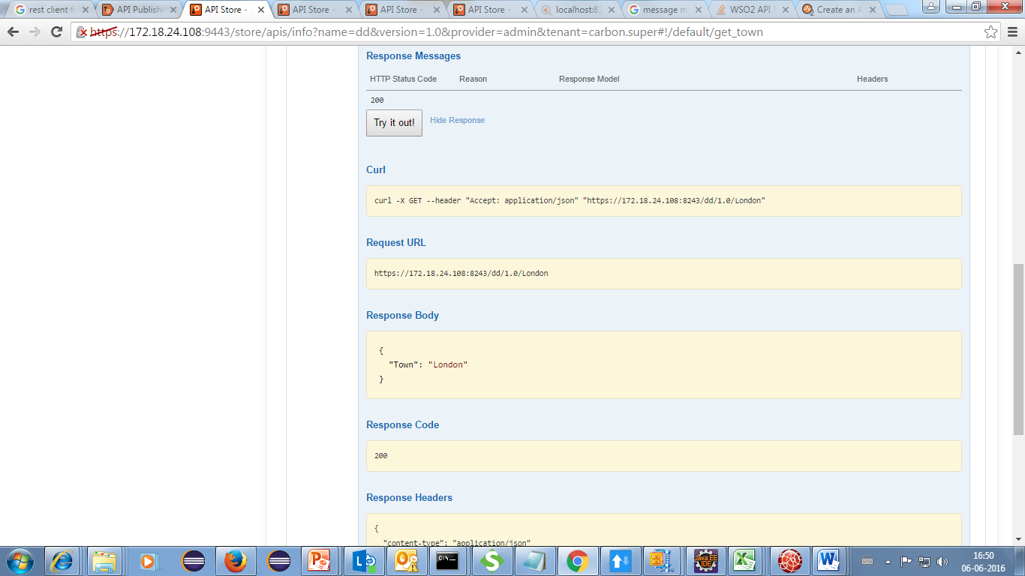
In WSO2 API Store
Give parameter and try it now
output

Slide 22
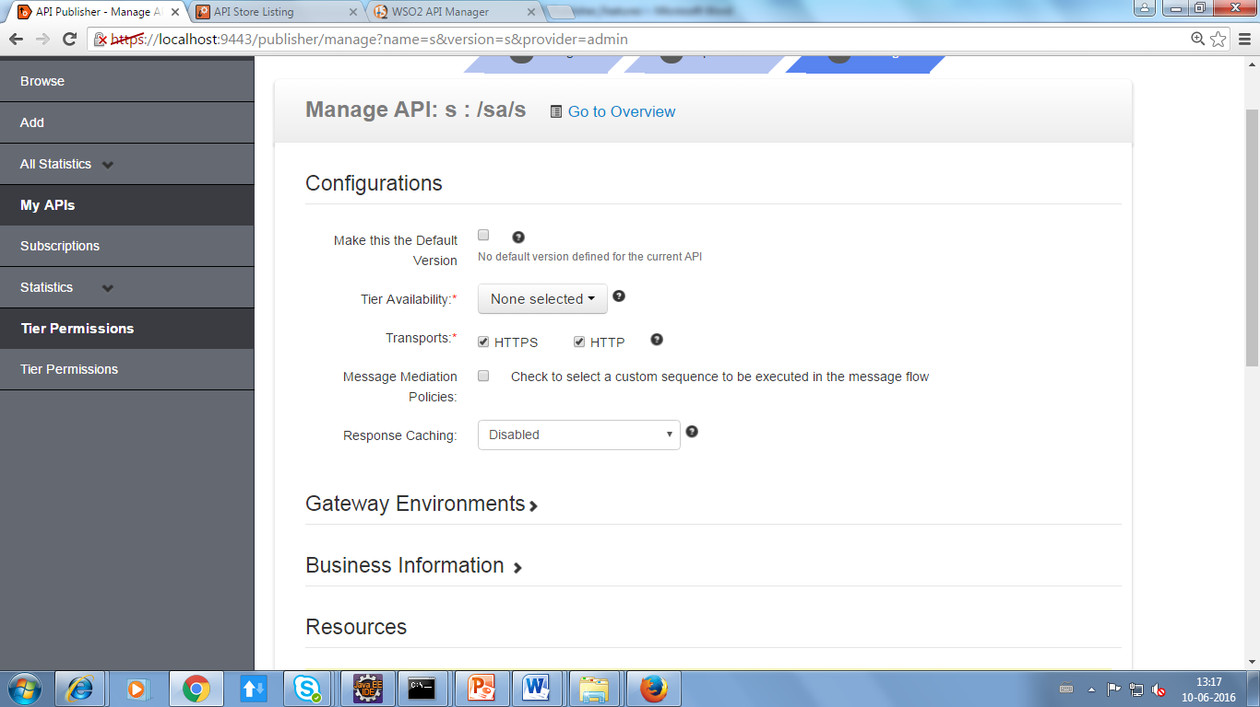
Manage API-Third Phase
Configuration
Make this the Default Version
Marks one API version in a group as the default, so that it can be invoked without specifying the version number in the URL.
For example, if you mark http://host:port/youtube/2.0 as the default API, requests made to http://host:port/youtube/ are automatically routed to version 2.0.

Slide 23

Tier Availability
Tiers limit the number of requests a subscriber can make to an API. An API can be exposed over one or more tiers
The Gold, Silver and Bronze tiers allow 20, 5 and 1 request/s respectively per minute.
Transports
HTTP is less secure than HTTPS and makes your API vulnerable to security threats.

Slide 24
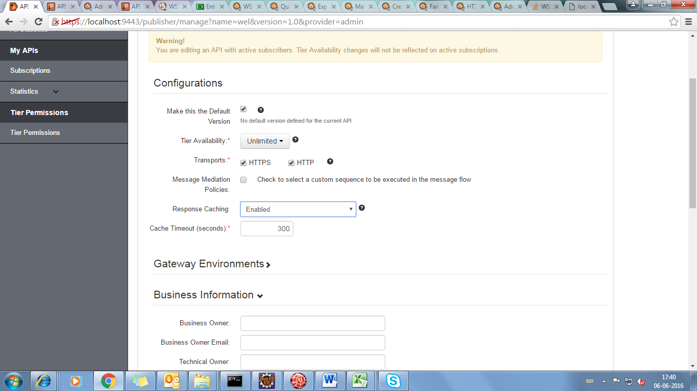
Response Caching
This option determines whether to cache the response messages of the API. Caching improves performance, because the backend server does not have to process the same data for a request multiple times. To offset the risk of stale data in the cache, set an appropriate timeout period when prompted.
If it is enabled it will automatically set the cache timeout(300 sec) ,we can change the time

Slide 25
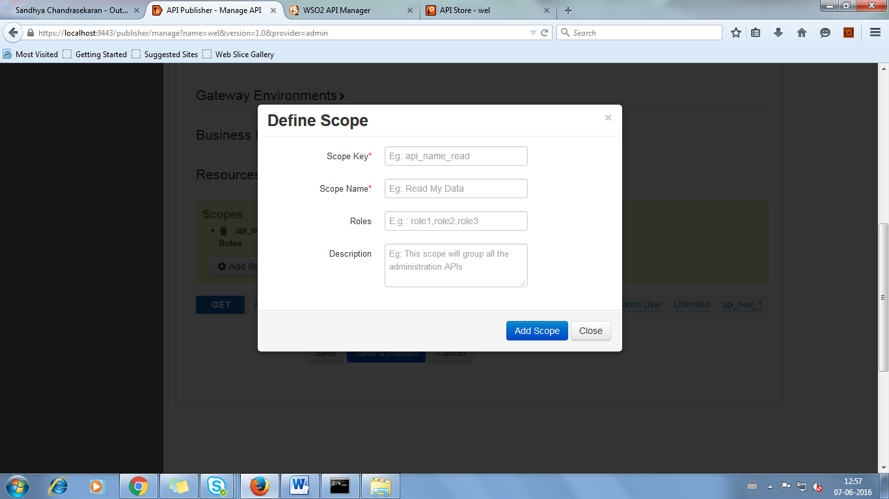
Resources
Add Scope:
We can scope so that it is visible in the API Store.

Slide 26
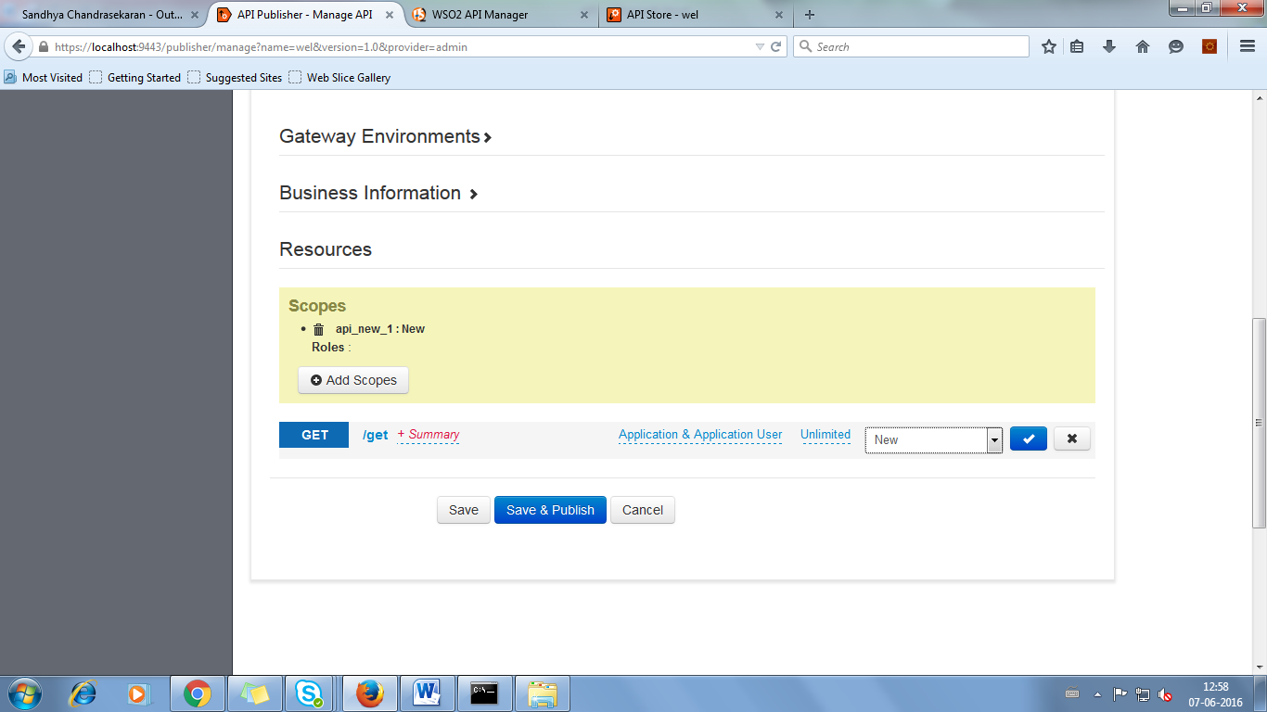
We have to select Scope which we have created and publish,it will visible in the key generation area in the store API of particular API

Slide 27
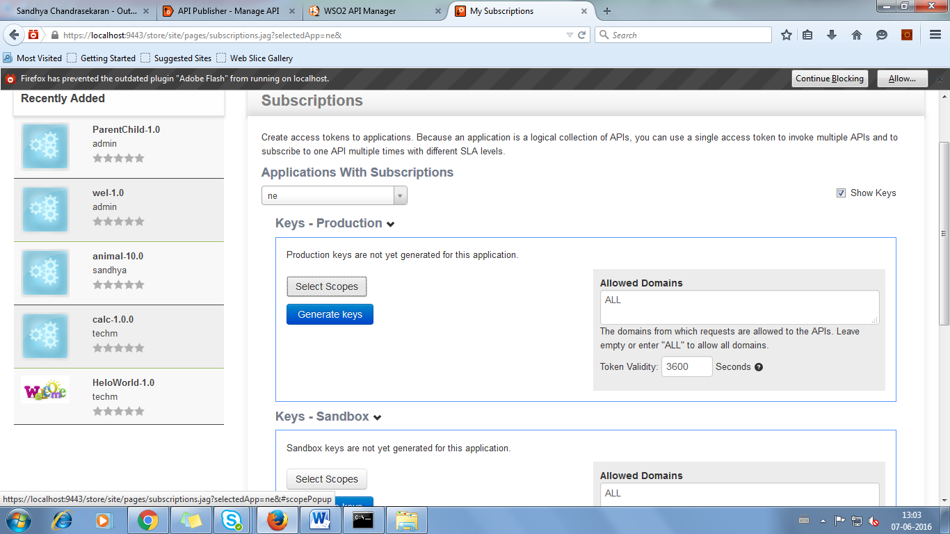
In WSO2 API Store .It will visible during the key generation
SELECT SCOPE
It will appear above the key generation area,we can select the particular scope which we have created

Slide 28
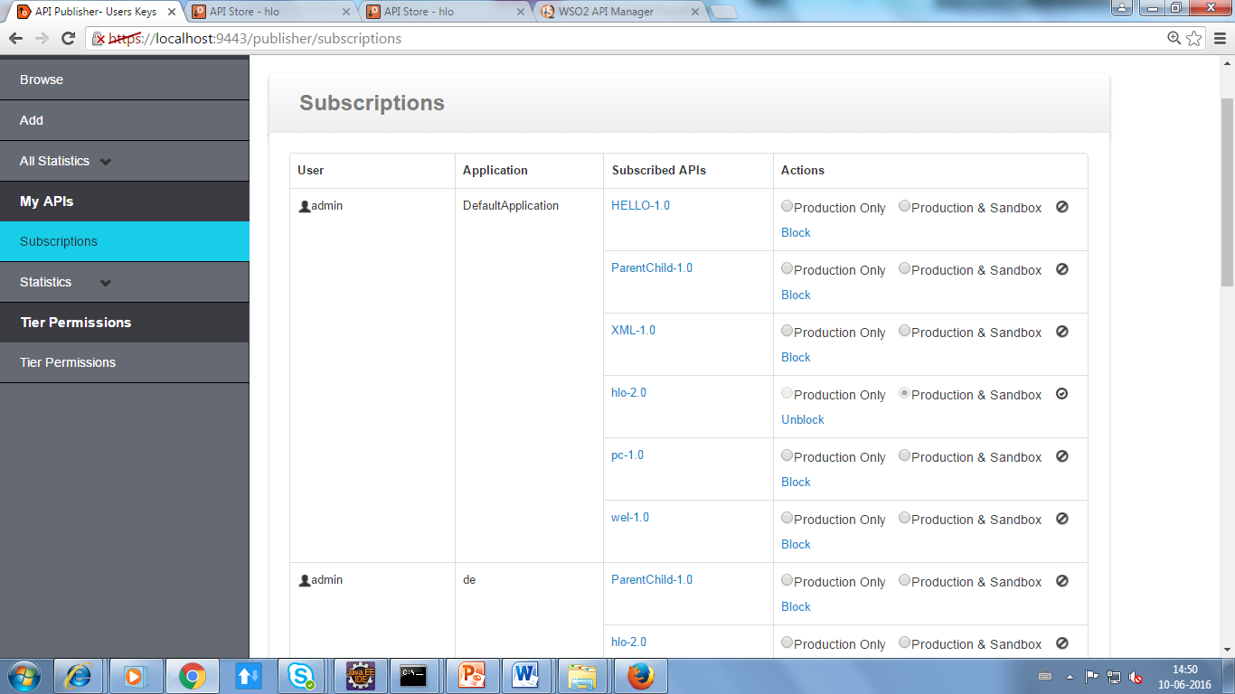
MY APIs
Subscriptions
This contains all the subscription list , contains information about user
who subscribe the particular API , under which application and also
shows whether the subscription is active or not
publisher can also block the API

Slide 29
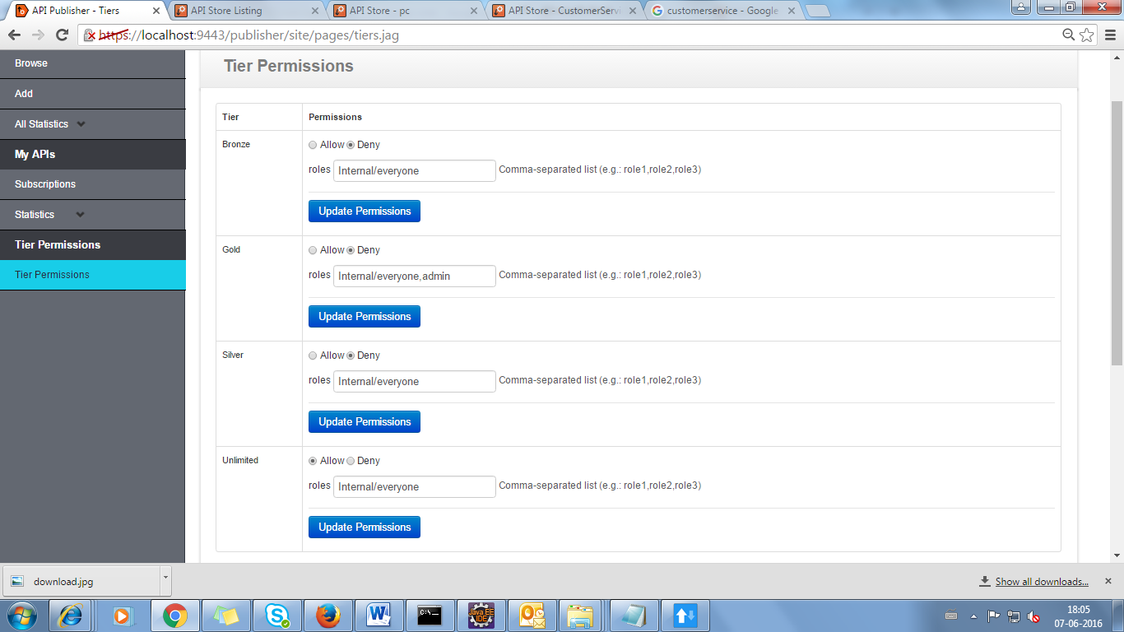
Tier Permissions
We can give tier permissions depending upon the role

Slide 30
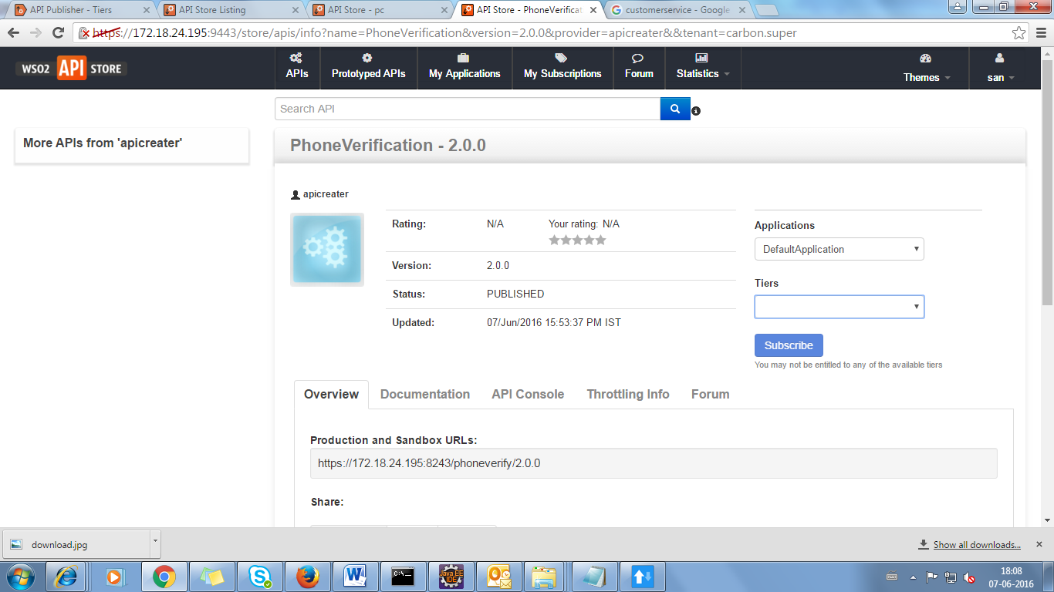
This will be reflected in the API store.
If we give all tier permission to deny in the former screen(tier permission),we can’t able to access any API’s

Slide 31


